Slide 1

Digitally Verifiable Credentials
For Paperless Services
Centre for Digital Public Infrastructure

Slide 2
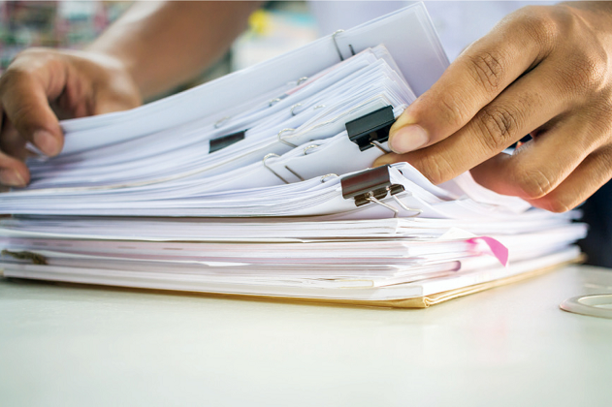
The societal cost of paper is ultra high in emerging economies

Slide 3





Employment
Lack of verifiable certificates is a hidden root cause of exclusion from key services & opportunities
Healthcare
Loans & Insurance
Government
Benefits
Education & Skill Training Certificates
Immunization Records
Business
Licenses &
Bank Statements
Eligibility
certificates
Notes:
Jobs
Skilling
Academic
Health
Businesses
Licenses - Trade

Slide 4








Your strategy should scale across government-held certificates
… and also privately held certs!
Identity cards
Business
licenses
Bank Statements
Hospital Records
Vaccine Certs
Land records
Employer Certificates
Schools/ University DIplomas
Public School Transcripts
Tax returns
Agri-tech
records
eCommerce records

Slide 5




Users currently are using ad hoc methods
Key to bring in better security and privacy while retaining simplicity and universality
Notes:
Question - data sharing that’s not triggered by an event, that’s needed at a higher frequency —--- continuous data requirement (DP- DC works better?)

Slide 6



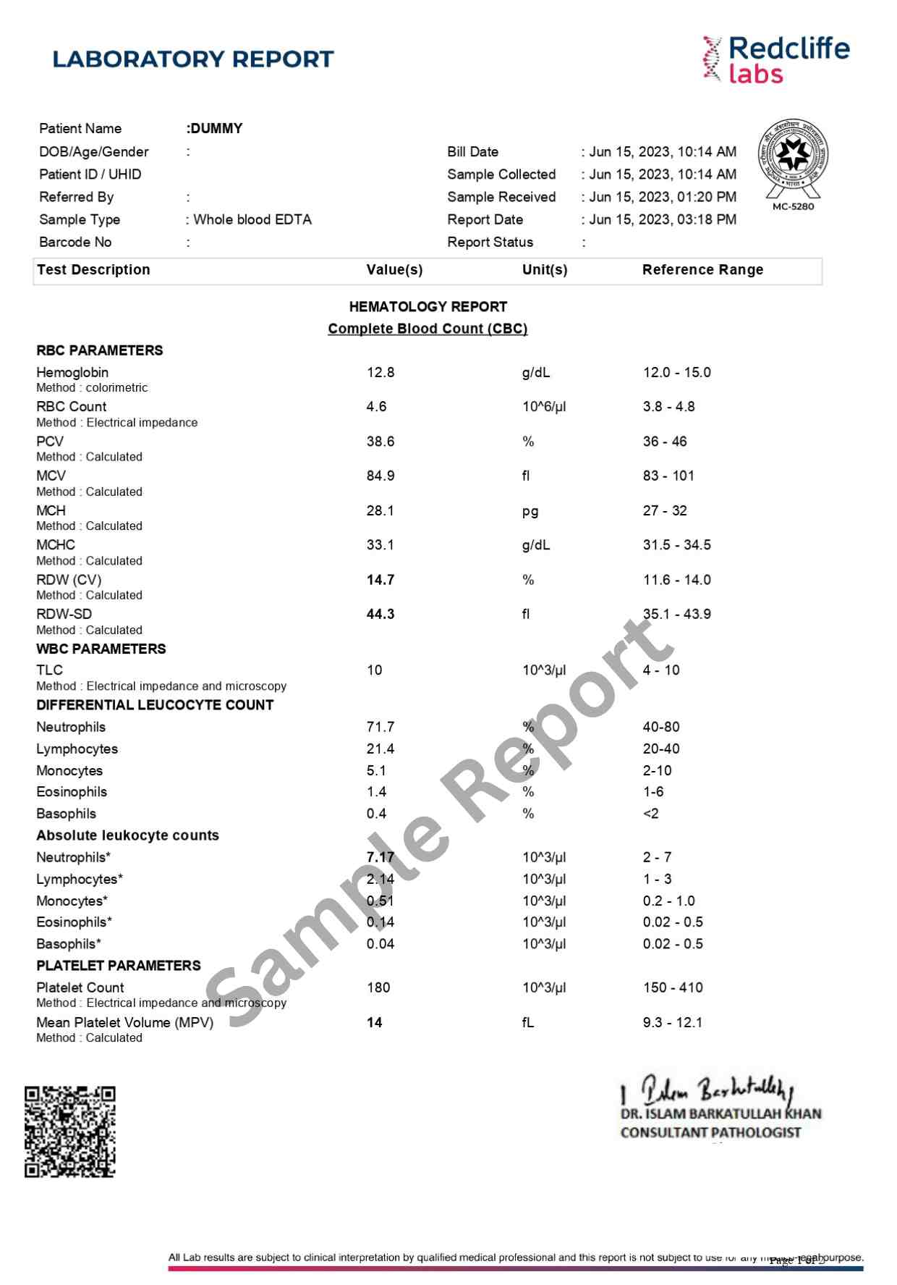

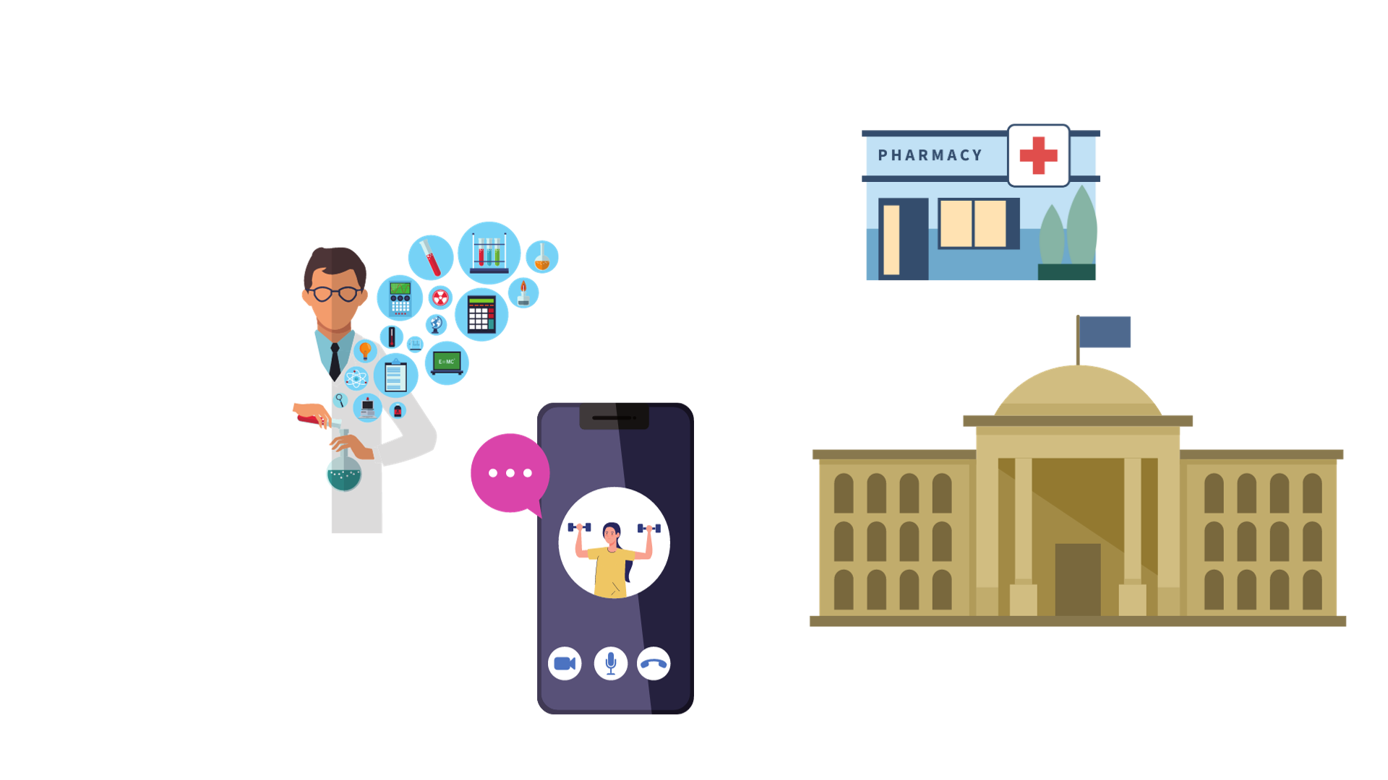
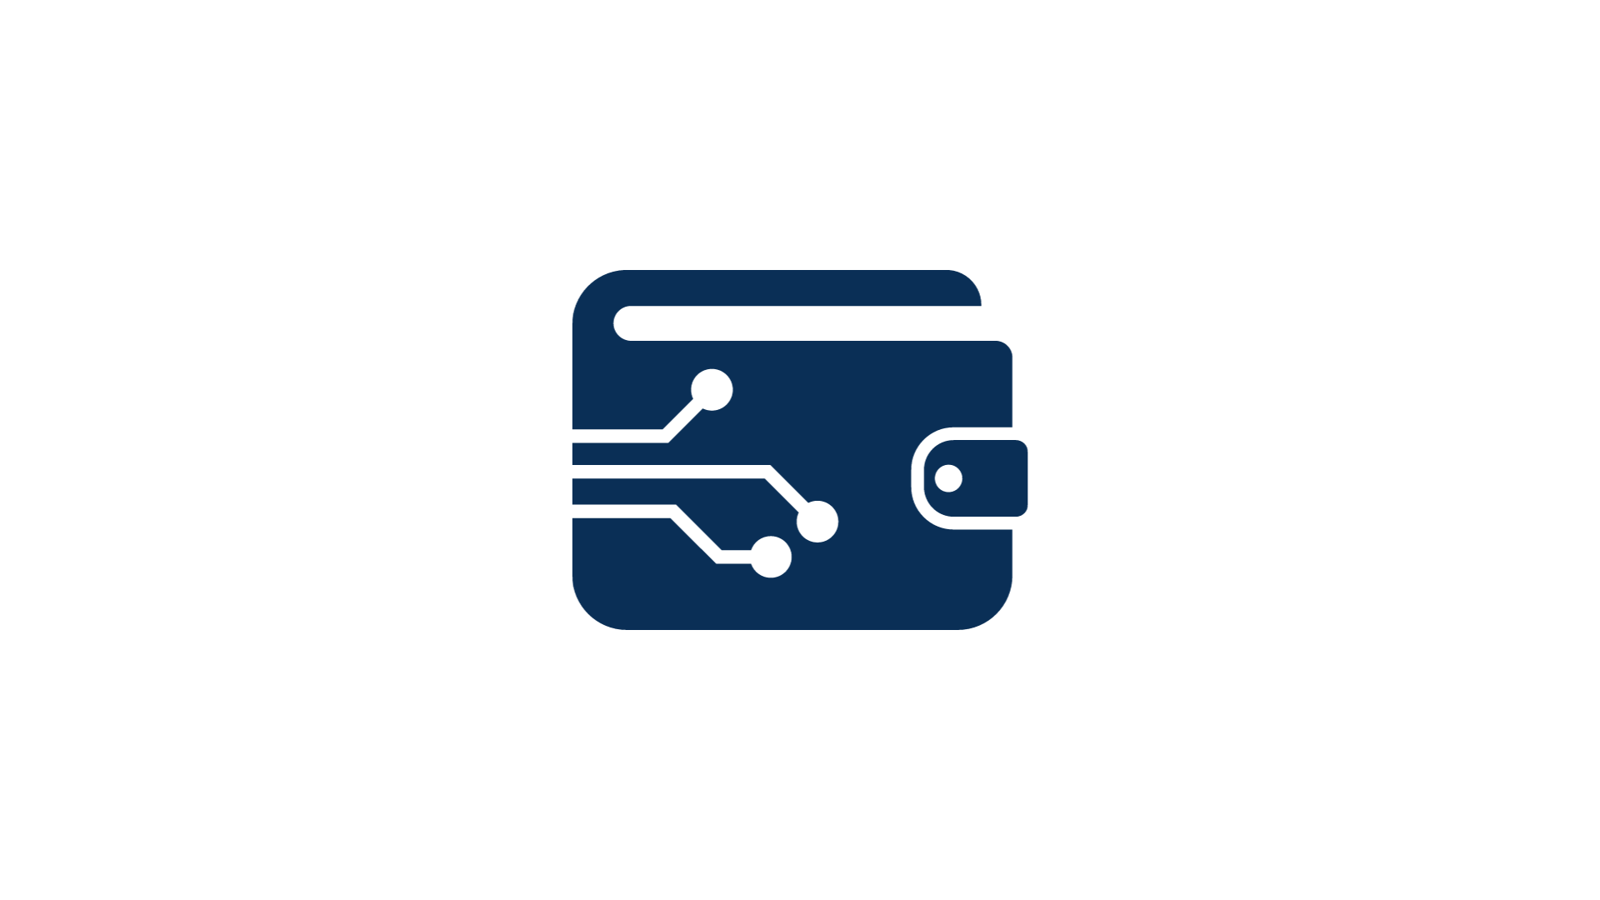
Giving paper back to the individual is already a
habit for institutions - add verifiability!
Credential Producers
Credential Users/
Service Providers
Shares onward flexibly
Paper based or
via e-wallets
Credential Owner’s ‘Inboxes’/Wallets
Banks, Hospitals, Government Depts, Schools, Businesses…
Machine readable Credential
Digitally Signed: Tamper-proof trust
Banks, Insurers, Govt Dept’s, Employers…

Slide 7


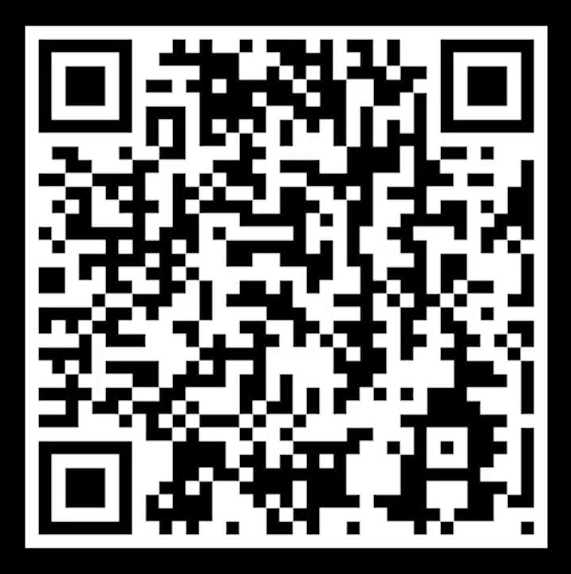
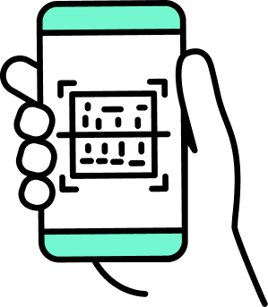
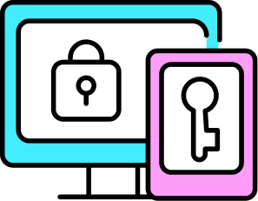


Any paper certificate/
card can be turned into a verifiable credential by adding a signed QR code with an ID binding!
Make certificates
High trust at
Low cost
Machine readable
Allows low cost review
Digitally signed
Tamper-proof & Trusted
Accessible via
Open APIs
Ease of market/gov’t reuse
Issued to Any ‘Inbox’
Paper binder, e-locker, digital wallet, or email!

Slide 8

This is a proven strategy!
In 2014, paper based certificates were prevalent in India
Today, 8+ Billion verifiable credentials are issued to 211 Million people
Notes:
Use cases: vaccines, income tax returns, school marks,

Slide 9
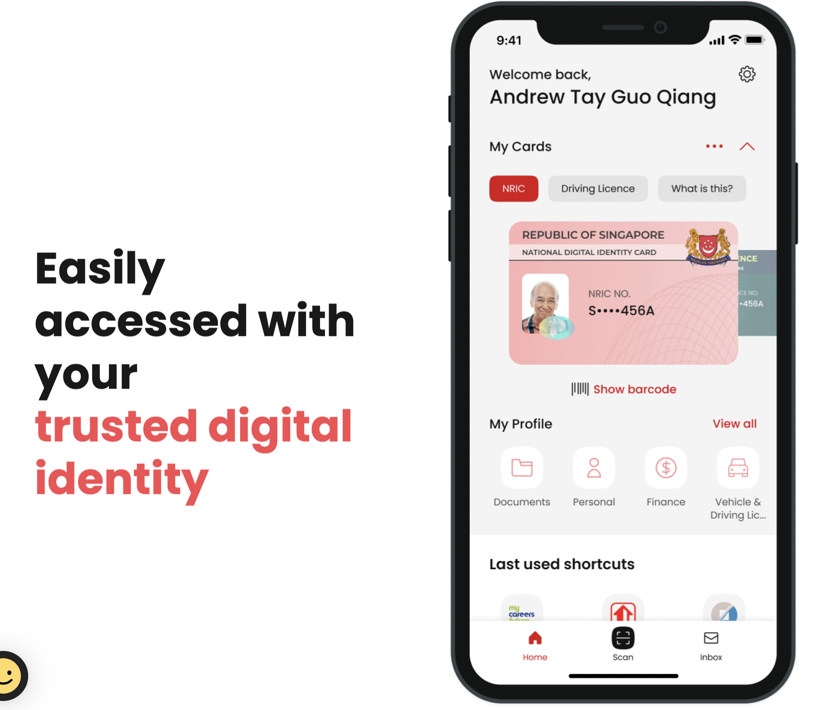
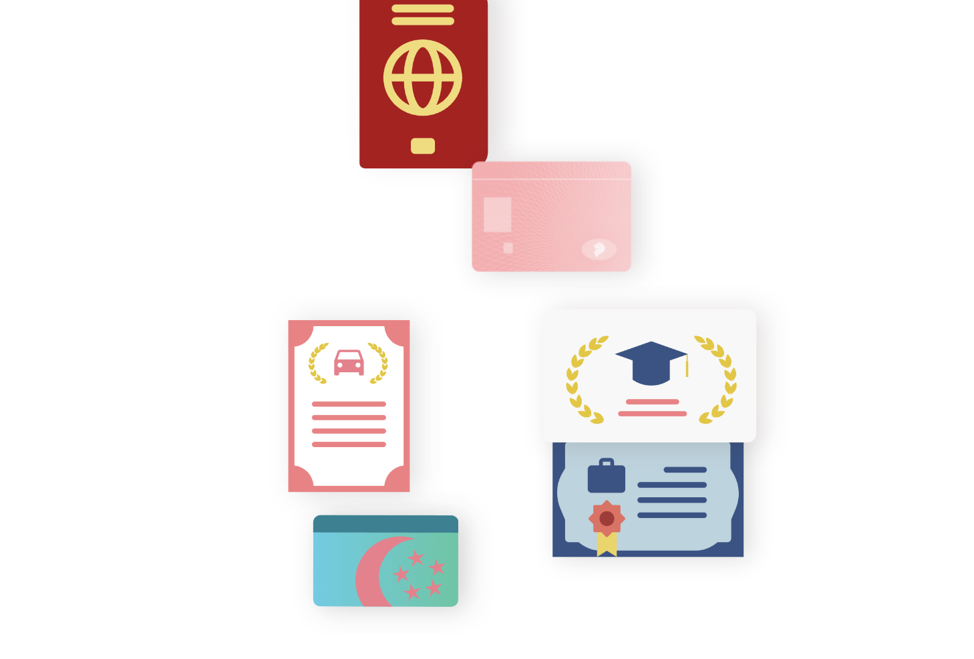
Singpass is also working on verifiable credentials!
Soon, every document
Singapore needs
will be

Slide 10

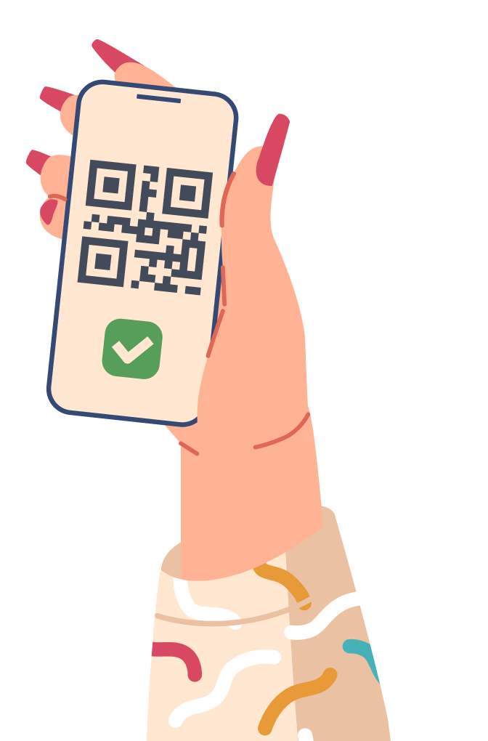
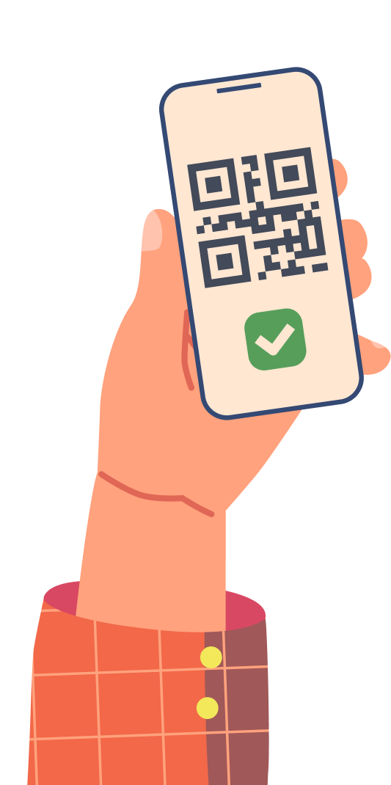
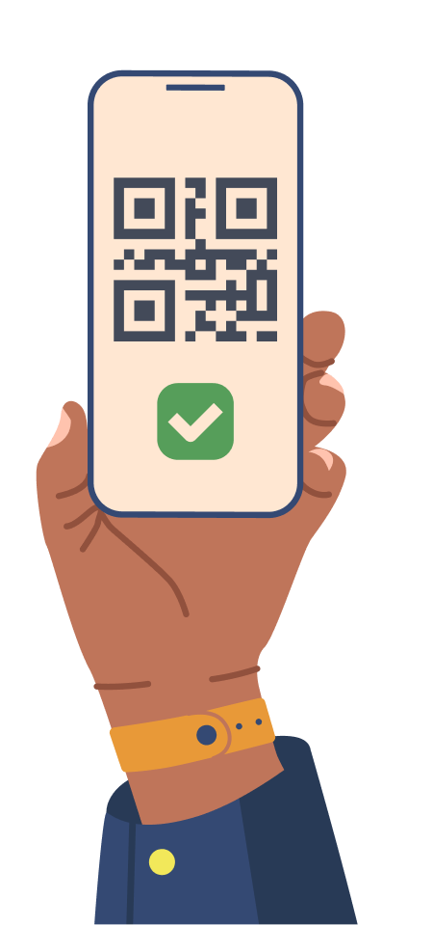
Verifiable Credentials infrastructure is a powerful DPI
for inclusion and innovation

Slide 11
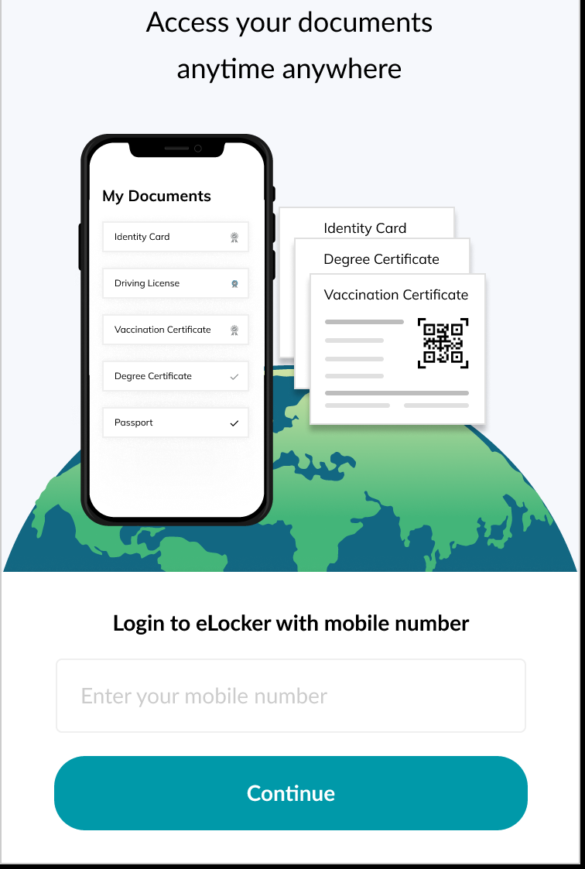
An example flow for how it could work

Slide 12
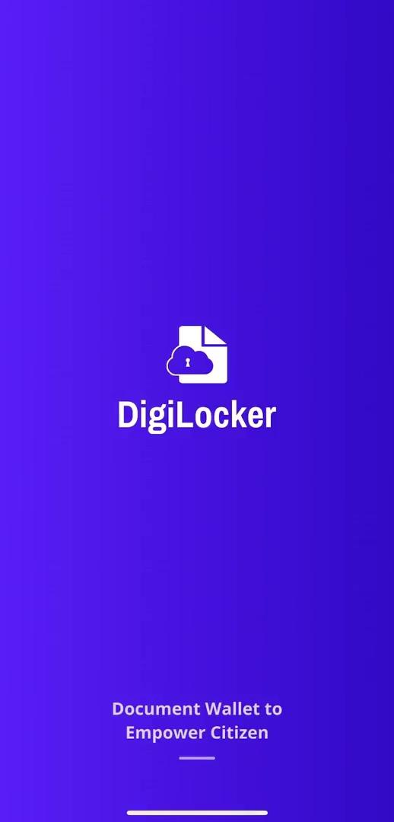
An example flow for how it could work

Slide 13
Thank You!
Let’s Talk: What do we need for scale?
Centre for Digital Public Infrastructure

